Slide 1




Prayas 21/12/2020

Slide 2




Executive summary
Problem statement
Solution brief
Uniqueness of solution
Impact and scalability
Potential roadblocks
About us
Demonstration Video
Agenda

Slide 3
Problem Statement - Despite being at the forefront of medical innovation, Indian medical infrastructure has fallen short in the case of patients afflicted with chronic illnesses in two broad situations: firstly, when the treatment is too expensive to be affordable for the common man, and secondly when it is too late, that is, the ailment has reached a stage where treatment proves to be futile.
There is no integration of existing solutions in the medical field, which makes the immense amount of data being collected redundant, on a day-to-day basis. It is not utilized adequately, which is what we envisage to change. We will be able to provide the populace with an earlier predictive resort, which forewarns.
Executive Summary
Target Audience - We aim at being the Health Lifestyle Facilitator for every common man, with our leaps envisioned to expand into even the most interior rural areas of India. However as we operate at the super-primary level of the health market for the masses, people who have already been suffering with chronic and/or serious illnesses of some kind, are not being targeted.

Slide 4


Proposed Solution - Our solution seeks to bring the entire Indian population under our purview, even with the rural areas on our radar, which face an inherent lack of quality medical intervention due to inaccessibility and lack of infrastructure. We cater with an application, which shall be operated by an administrator of expertise in the rural areas, in filling responses, to a detailed health questionnaire.
Health sensor nodes will supplement the work to collect diagnostic data, send it to the coordinator (an IoT device) and enable our data science model to predict the condition the subject might be suffering from, or is likely to head towards, in the near future. If the prediction directs towards a specific ailment, a CBC (Complete Blood Count) report can be provided at an extremely low cost. It serves to provide more resolution into the prediction of the disease, as a CBC report can guide towards more conclusive evidence for most of the common blood profile-related diseases.
Impact - This can help save the lives of millions, who are oblivious to the vagaries of sicknesses that may befall them in the future. With the power of data, we can potentially collaborate with doctor-hosting services, testing facilities, and medicine-hailing services, to provide an end-to-end Disease Prevention solution.
Stage of Innovation - We are currently in the Proof of Concept stage. The application is in development and ready to be deployed soon. The data science model is set for scrutiny by medical experts and is projected to get ready with mentoring.

Slide 5
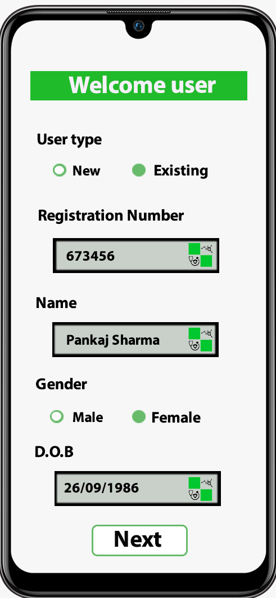
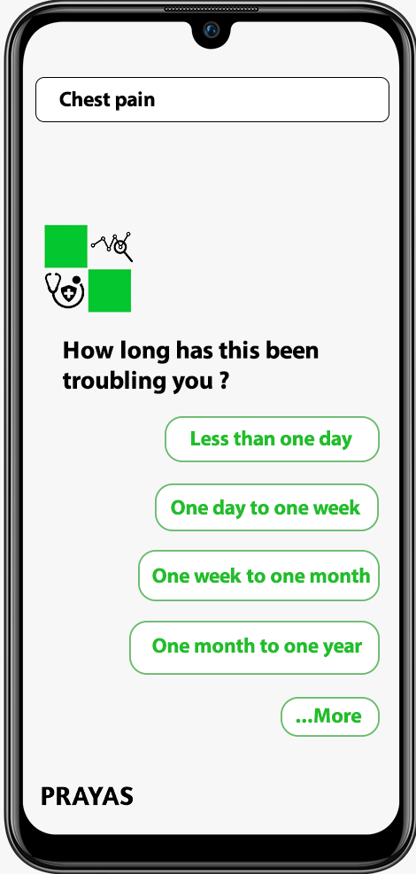
Our React Native based application under development

Slide 6
Problem Description - Indian medical infrastructure has not been able to mitigate the unpredictability associated with curing late-stage terminal illnesses, where affordability and accessibility pose a problem to the average rural, as well as urban, Indian. As of 2019, India has over 69,000¹ hospitals.
Services have not been integrated correctly, to make use of immense medical data ethically, recorded everyday (within the guidelines of HIPAA² rule). It has been aptly said, “prevention is better than cure” and hence, we aim to empower the citizenry with increased certainty, in terms of health and well-being. State-of-the-art analytics can forecast trends which can increase the reliability of health services. Attacking the disease in its infancy could enable its prevention, which has not been the case till now.
Our objective is to contribute towards improving India’s mortality rate, which is driven by the detection of health problems which have been seen to be fatal in later stages. For instance, in 2016 cardiovascular diseases accounted for 28.1% of total deaths³ in our country, even though it is treatable in every four out of five cases. In a similar vein, early detection can prevent mortality from Tuberculosis, which alone killed over 4 lakh Indians⁴ in 2018.
Problem Statement

Slide 7
Awareness in the countryside is of utmost importance since the penetration of medical infrastructure is low⁵. A spur in rural demand for better healthcare can prove to be a win-win situation for the villagers as well as medical suppliers. While the former will be able to enjoy the better treatment and hence improved quality of life, the latter will play their part in meeting this perceptual change and grow in a sector yet untapped.
Problem’s Importance - It might be that Indian medical infrastructure is developing a lot but it still is not sufficient enough to cater to the needs of the general public. The rural residents often encounter barriers to healthcare along the dimensions of proximity, affordability, and quality when compared with their urban counterparts. They usually have to travel long distances to access such services, which directly or indirectly becomes a significant burden in terms of travel time and cost.
It has also been seen that due to late diagnosis, people usually start their treatment at later stages where treatment becomes less effective. This results in the ongoing transmission of serious infections and sometimes, delay in the identification of emerging threats like situations of pandemics. Early detection of diseases plays a crucial role in all treatment and prevention strategies. Rapid and accurate identification of the underlying agent (the bacterium or virus) using diagnostic testing is essential to select the correct control measure, such as containment, confinement, antimicrobials, and vaccines.
More than 50% of the mortality rate of India is just because of late detection of diseases.

Slide 8
Proposed Solution - Our application will enable the users to register themselves and create a unique account (for future recommendations), which shall be done by an authorized administrator in the case of rural areas, where low digital literacy is a potential impediment. The user goes through a questionnaire, which is adaptive of the initial response(s). An assistive interface, along with administrator’s assistance (in the case of villages) will ensure the efficacy of the procedure.
After it is filled, the same is examined by a model trained on millions of historical responses, over and over. The model retrains itself with every new response, which testifies to its scalability. The Machine Learning model will look for correlations and revert back with suggestions. In case a Complete Blood Count (CBC) report is necessary, we shall provide them the same, at a minimal cost, using the affordable CBC kit, an IIT KGP innovation⁶. This will be conducted under the supervision of a trained administrator.
The CBC report is considered a preliminary in medical treatment, for a gamut of diseases. For blood profile-related ailments, it is extremely crucial for diagnosis. The metrics obtained are fed into another model, which provides a clear resolution of the plausible medical condition. The former is based on the statistics from the first analysis, which include BMI, patient’s age, gender, region etc.
Solution Brief

Slide 9
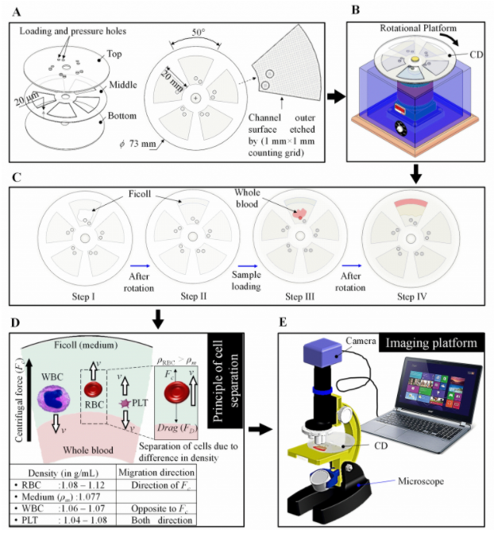
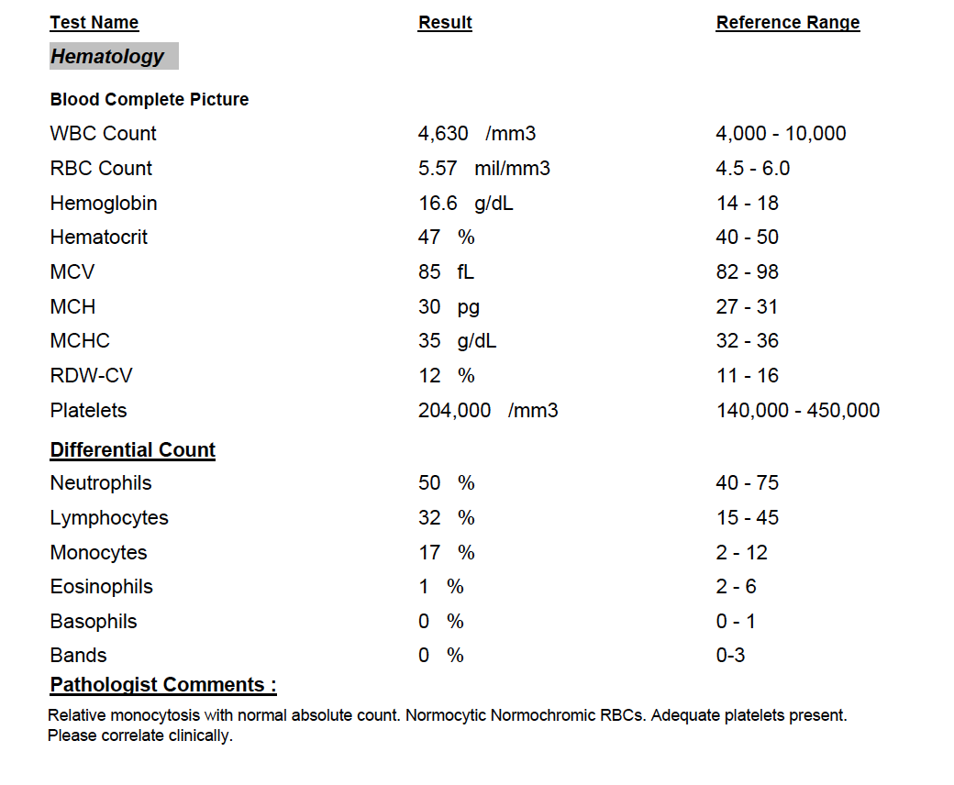
Cheap CBC Test
CBC Sample Report

Slide 10
The next step sees our collaborators step in - for confirming the morbidity, partner testing facilities will be utilized. Access to domain-specialized doctors will be provided through partner medical consultancies. Simultaneously, medicines can be delivered to the patients, after the same has been validated by a legal practitioner, using medicine supplier companies.
All in all, this facility ensures that the user gets to know about their health status, and receive red flags, if any, along the course of their interaction. A conscious effort to make the procedure smooth and devoid of unnecessary human interaction ensures that the patients can use our facility as a lifestyle facilitator, which can potentially be a shot-in-the-arm for rural medical infrastructure.
The demand created in the last step, for testing facilities, practitioners, and medicine suppliers, will enable these players to thrive in an unexplored market segment. While this makes the option lucrative, the public good remains at the core of our idea. Reliable diagnosis, hassle-free interaction, and a comprehensive end-to-end preventive solution ensure that the country is able to fight and sustain in the face of a growing incidence of deaths due to terminal ailments.
We stand in good stead to deploy the application on the ground soon, which will enable the outstanding steps to kick in. The machine learning model is being set for a thorough examination as well; the suggestions from the panel would be incorporated to allow the complete procedure to take off.

Slide 11
The CBC monitor has been developed by our fellow engineering researchers at the Indian Institute of Technology, Kharagpur. Each test is carried out at a meager five percent of the existing market expense, which makes it highly affordable. The results are pretty accurate and the disc used in this device is biodegradable, which is an indispensable advantage. More details regarding the same can be found here.
To summarize, we operate by connecting the dots together, by collaborating with varied entities and bodies, and deploying cutting edge twenty-first-century technology, so that our country’s fragmented healthcare system becomes more affordable, accessible and reliable, to those in its dire need, despite their ignorance.
Technology - React native is being used to develop a cross-platform application. Artificial Intelligence (AI) chatbot will be used as an interface for obtaining inputs, in conjunction with Geneea Natural Language Processing API. Firebase shall facilitate storage of responses, which shall be indispensable at two aforementioned stages. These will be analyzed using a Machine Learning(ML) model, while the CBC report shall be prepared using pdf parser and Html. BigML API will be used for building diseases’ predictive model, while Statistical Analysis Software (SAS) enables statistical modeling. React JS will be used in the near future, for building the web application.

Slide 12
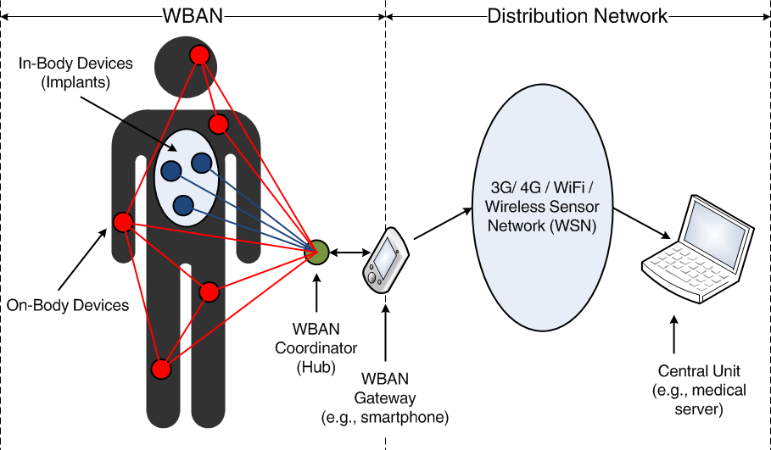
Health Sensor Nodes functionality

Slide 13
Innovativeness - Solutions and innovations conceived and developed to date have primarily focused on Disease Attack. While the approach is a necessity for some situations, it is not devoid of an inherent flaw: acting too late. This allows the parasite to incubate and harm the host, which is accompanied by the unknowing spread of the agent, in case of communicable diseases.
As far as diseases like cancer and kidney damage are concerned, the late intervention might not result in complete healing. Chemotherapy and recurring treatments like dialysis seldom allow the patients to revert back to normalcy. There is a permanent effect on the quality of life, which does not bode well for society. Deaths are inevitable when one brings the factor of accessibility and affordability of expensive, quality healthcare, which is concentrated in urban areas.
We instead focus on Disease Prevention, that is, relieving the problem in an earlier stage, which serves as a turnaround for previously mentioned problems. Predicting the ailment in advance and beginning the treatment early prevents like cardiovascular diseases⁷ and TB (in over 80% cases) from causing a fatality.
Uniqueness of Solution

Slide 14
All in all, we do not have a crystal ball. However, having a growing dataset with active analysis using state-of-the-art techniques and collaboration with various medical service providers can lessen the mortality rates in younger and older population groups with timely caution. Disease prevention is the underlying strategy, which will also see the rural population witness an unprecedented change in perceiving their lifestyles.
In fact, the solution doesn't just help in eradicating chronic ailments from the country but it will also help in acting as a survey for the Government of India. With huge datasets, we will be able to trace out non-medical issues, for example, essential mineral content of water in a particular area, particular traits visible in particular regions etc, which will further help the country to annihilate tropical conditioned and regional diseases. These account for many casualties in the rural section of the country.
Unconventional Vision - As undergraduates in engineering schools, innovating in the domain of medical technology may not come across as customary. However, we are led forward by the zeal of working towards the greater good of our nation, which has not been able to ensure a satisfactory and affordable health system for its burgeoning population.
We were able to devise a solution that is highly technological at its heart. All we need is quality mentoring from the best in the business, which is what ZS prize boasts of. A large scale deployment could even enable us to make wide-reaching predictions, which could prove to be pivotal in discovering the root causes of endemic illnesses.
It will also come as a welcome change in the way medical innovation is perceived. A platform of ZS Prize’s stature will also enable us to vocalize our solution. Curbing the spread of diseases will also lead to an overall improvement in our living standards, as citizens of the world’s second-most populous nation.

Slide 15
Impact - Earlier detection of diseases usually leads to successful treatment and longer survival. According to the CENSUS⁸ Data 2010-13, it has been observed that out of the possible reasons for all the deaths in India, 77% of them are related to a disease or medical condition, and about 55% of the diseases, if detected early, can be cured. However, public health programs recommend the public to have periodic screening examinations so as to predict/detect any morbidity, but such examinations, when embedded in a public health program, are invariably costly and are ordinarily not chosen on the basis of possible trade-offs in costs and benefits for different screening schedules.
The possible candidate number of examination schedules is so large that it is not feasible to carry out clinical trials to compare different schedules. This problem was theoretically studied and our proposed idea gives us the confidence that out of those 55% treatable cases⁹, even if 50% were considered, we can help eliminate the minor cases of morbidities, for ex: digestive diseases, diarrheal diseases, malaria, infectious diseases etc. within a span of 3-4 years and the major cases, for ex: cardiovascular diseases, pulmonary diseases, neoplasms and tumors, tuberculosis etc. within a span of 7-8 years.
Impact
&
Scalability

Slide 16
Considering the mortality rate of India for the past 10 years, the curve has been going down by a factor of 0.1 per 1000 people per year¹⁰, but with successful application of our model, we assume that this factor of 0.1 will increase to 0.15. Considering the ongoing advancement in medical science and technology, we can estimate this factor to reach 0.25 per year. Our model is general for diseases and can be applied to most of the chronic diseases and with successful implementations, we will easily be able to prevent schedule sensitivity and its relation to reduction in disease-specific mortality.
Scalability - In the long run, we aim to have every Indian on our platform, who is not suffering from a chronic sickness already. Keeping the objective in mind, we have opted to make our platform as portable as a smartphone: install the application, sign in and have assured facilities right under your fingertips. With the support of ZS Prize, we envisage to bring the quintessential urban dweller into our fold, residing in cities and towns across the length and breadth of the nation. The administrator-based rural area model will start off as soon as financial aid is initiated, with a pinpoint focus on taking one panchayat at a time.
Within a year of deploying the application pan India, across smartphone platforms, we anticipate to have chalked out collaborations with firms pioneering in online doctor conferencing, delivery of medicines and testing facilities, across most Indian cities. With the increased demand for these health services, there will also be a positive response in the nation's economics in the domain of health, which will directly aim at increasing life expectancy of the nation.

Slide 17
A SWOT analysis of our idea reveals that our inherent strength is scalability: reaching a large number of people in a very small time, which is well complemented by low fixed costs. With collaborations expected to be struck within a year of launch, we have an opportunity in the form of a constant inflow of revenue, while revolutionizing the Indian health market.
There can be weaknesses, which are enumerated below. In the beginning, our machine learning model may have a tough time making sense of outliers, which is unavoidable when the dataset is small. There is a low but non-zero probability of making a mistake, which can be offset by suitable programming: instead of wrongly identifying a presence of sickness as its absence, the vice-versa will be the case. Even in case of the slightest doubts, a real appointment with a doctor would ensure that the experience does not turn out to be grim, for the user.
Our idea is not to make an attempt to replace the medical practitioners, who are highly skilled in their work. However, having a confirmatory test in case of slightest doubt on part of the user is necessary for peace of mind. The initial cases of false positives are projected to turn out to be negative, which is morally emphatic, doubtlessly. In the later stages though, if a user opts to take a test before the model suggests one, it will turn out to be redundant.
Potential Roadblocks

Slide 18
On the brighter side, these are just predictions being made by the model based on correlations of various factors taken at once. Predictions do not cause harm to anyone. Nonetheless, the complex machine learning model will be based on reinforcement learning, that is, the model rewards itself after making a correct prediction. The level of significance shall be low for a small dataset, which translates to a higher confidence level. With a constant growth in the number of responses, this can be gradually lowered, which will ensure false positives are weeded out.
All in all, the predictive power of the model shall remain high, with very few false positives early on. Covering even about 0.01% of a region’s population can provide highly trustworthy insights, which in other words, refers to correct identification of potential risks for a user.
Threats may arise later on, with an unexpected change in the financials and large-scale, uncalled political intervention. We believe, though, that associating with ZS Prize will ensure that we are able to tide over the same.

Slide 19
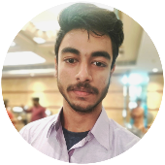



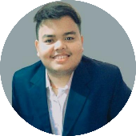
Arpan Mukherjee
An Instrumentation and Electronics undergrad at Jadavpur University.
Has cultivated various viable startup ideations in hackathons and business challenge competitions.
Is an active member of the varsity’s Entrepreneurship Cell.
Management Lead
Durgapur, India
7699016116
arpanmukh11@gmail.com
About Us
Priyatam Piyush
Pursuing B.E in Printing Engineering from Jadavpur University.
An avid programmer, who has interned with multiple multinational companies.
Has a deep understanding of data science, development and analytics.
Tech Lead
Patna, India
6201087076
piyushpriya435e@gmail.com

Slide 20
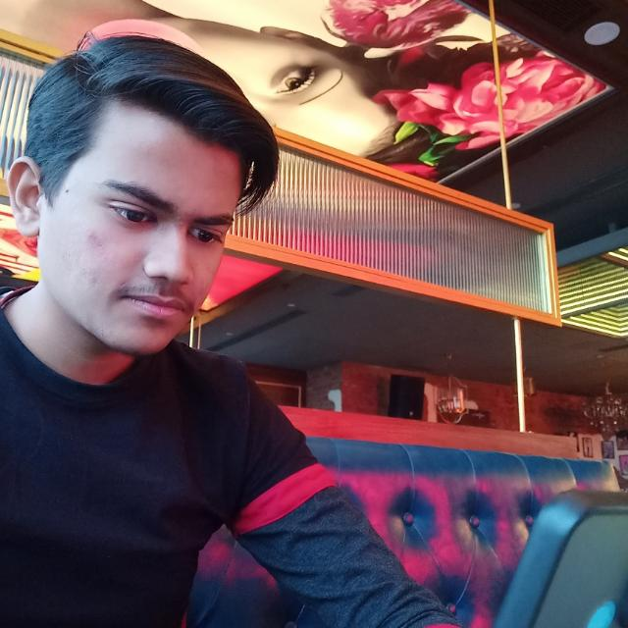
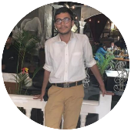
Yash Gupta
A Mechanical Engineering sophomore at Jadavpur University.
Has a keen interest in web and app development, with emphasis on elegant designs
Has interned in web development roles and has a knack for solving complex problems.
Brand Integration Lead
Howrah, India
9330352781
yashgupta2673@gmail.com
Ayush Pareek
A Civil Engineering undergrad at Jadavpur University.
Inclinations include programming, finance, data science and economics.
Worked as a content curator and core member at Entrepreneurship Cell.
Content Lead
Howrah, India
7596868765
mstorage72@gmail.com

Slide 21
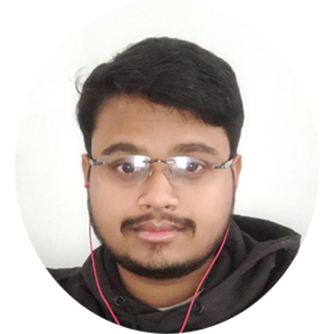
Om Saswat Sahoo
A biotechnology engineering undergrad at National Institute of Technology, Durgapur.
Likes to keep track of latest developments in the world of healthcare, while aligning the same with issues specific to our country.
Has worked as a web content writer for his institute’s incubation cell.
Research Lead
Kharagpur, India
7872688982
omshrivali@gmail.com
Team’s Competence - Team Prayas has set out with a target to revolutionize the Indian healthcare system. Priyatam Piyush, a dexterous programmer, who, among various other disciplines, is well-versed with the intricacies of data science and guides the other members.
Arpan Mukherjee is adroit at making sense of problems; he has tactfully proposed multiple viable startup ideations across acclaimed competitions.
Yash Gupta is a web and application development enthusiast, who specializes in designing as well.
Om Saswat Sahoo is a keen observant of trends in medical sciences, especially those which pertain to ailments and lifesaving drugs for the same.
Ayush Pareek dons the role of curating content and has an inclination towards economics, and data science.

Slide 22

Demonstration Video
- https://youtu.be/b9gROAWqD6k
References –
https://www.statista.com/statistics/1128739/india-number-of-public-and-private-hospitals-by-state-estimated/
https://www.bit.ly/3mCr46R
https://www.statista.com/statistics/990497/india-deaths-due-to-cardiovascular-diseases-by-type/
https://indianexpress.com/article/india/coronavirus-india-top-infectious-disease-tuberculosis-6365732/
https://www2.deloitte.com/content/dam/Deloitte/in/Documents/life-sciences-health-care/in-lshc-medical-technology-in-India-noexp.pdf
https://economictimes.indiatimes.com/news/science/iit-kgp-develops-device-that-can-perform-cbc-test-at-rs-10/articleshow/73203606.cms?from=mdr
https://bit.ly/2KNCkQk
https://censusindia.gov.in/vital_statistics/causesofdeath.html
https://docs.google.com/presentation/d/1iel6Ch0CsSNfbvbxT0rGOkcNAKc1MDtU/edit#slide=id.p2
https://bit.ly/38utNua
Prototype
&
References

Slide 23

Thank You !

